Slide 1
October 2017
Accelebrate
On-Site, Customized Technical Training
DATA SCIENCE WEBINAR
Fanning the Flames: An Unfair Comparison of Python and R in Data Science Applications
https://www.accelebrate.com
info@accelebrate.com
International: +1 678 648 3113
US & Canada: +1 877 849 1850

Slide 2
Fanning the Flames
An Unfair Comparison of Python and R in Data Science Applications

Slide 3
sPython —"Space Python"
Popular massive-multiplayer game
Players fly gigantic snake-like spaceships
Compete to devour planets, gaining resources
Sales derive from in-game purchases
The company needs a Data Scientist to answer one question:
Did their recent marketing promotion increase in-game purchases?

Slide 4
Which Tool to Use?
There are really only two main tool choices in (general-purpose) Data Science!

Slide 5
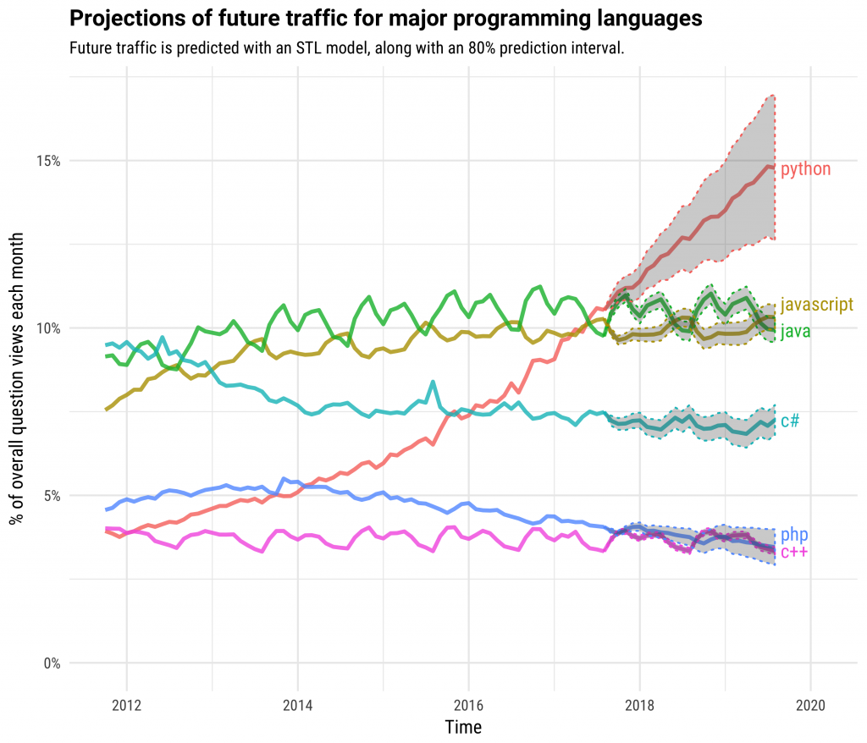
Source: StackOverflow (2017)

Slide 6
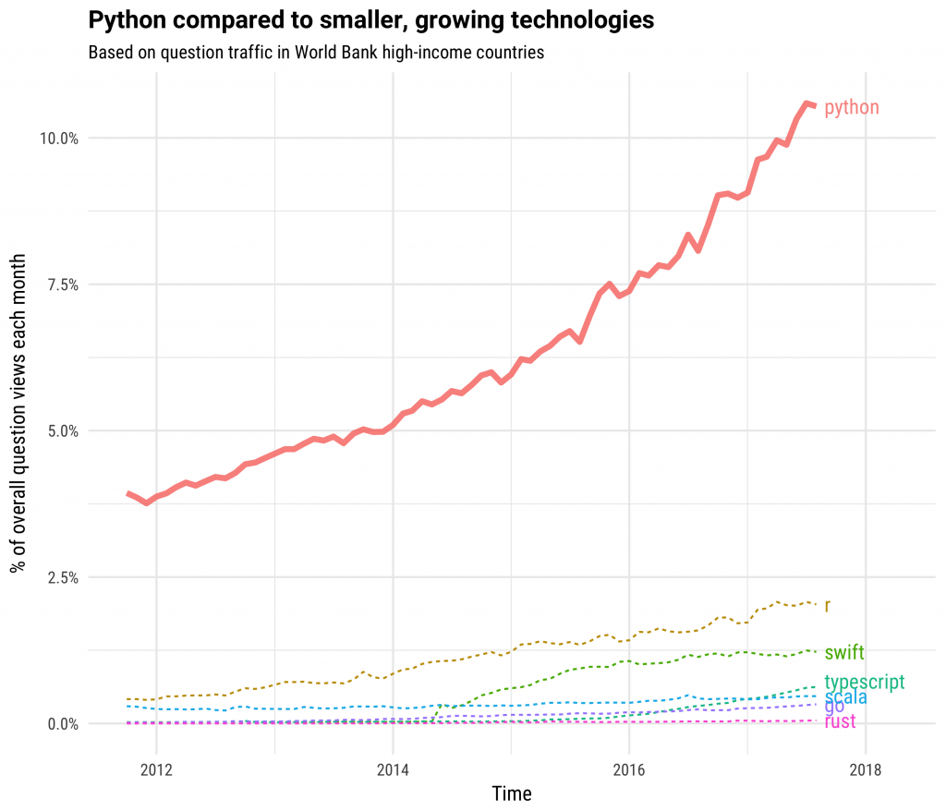
Source: StackOverflow (2017)

Slide 7
Why are these Tools so Popular?
Open-source
Relatively accessible to beginners
Broad eco-system in the scientific stack
Increasingly performant
Cultural inertia
Great community!

Slide 8
The R Project for Statistical Computing
Initial release in 1995 by Ross Ihaka and Robert Gentleman
A modern implementation of the S language (Bell Labs)
Widely used and developed by statisticians
Rich support for advanced statistical analysis and visualization
Vast number of packages (currently almost 15,000)
Object-oriented
Clean syntax
Friendly for 'non-programmers'
Great community support

Slide 9
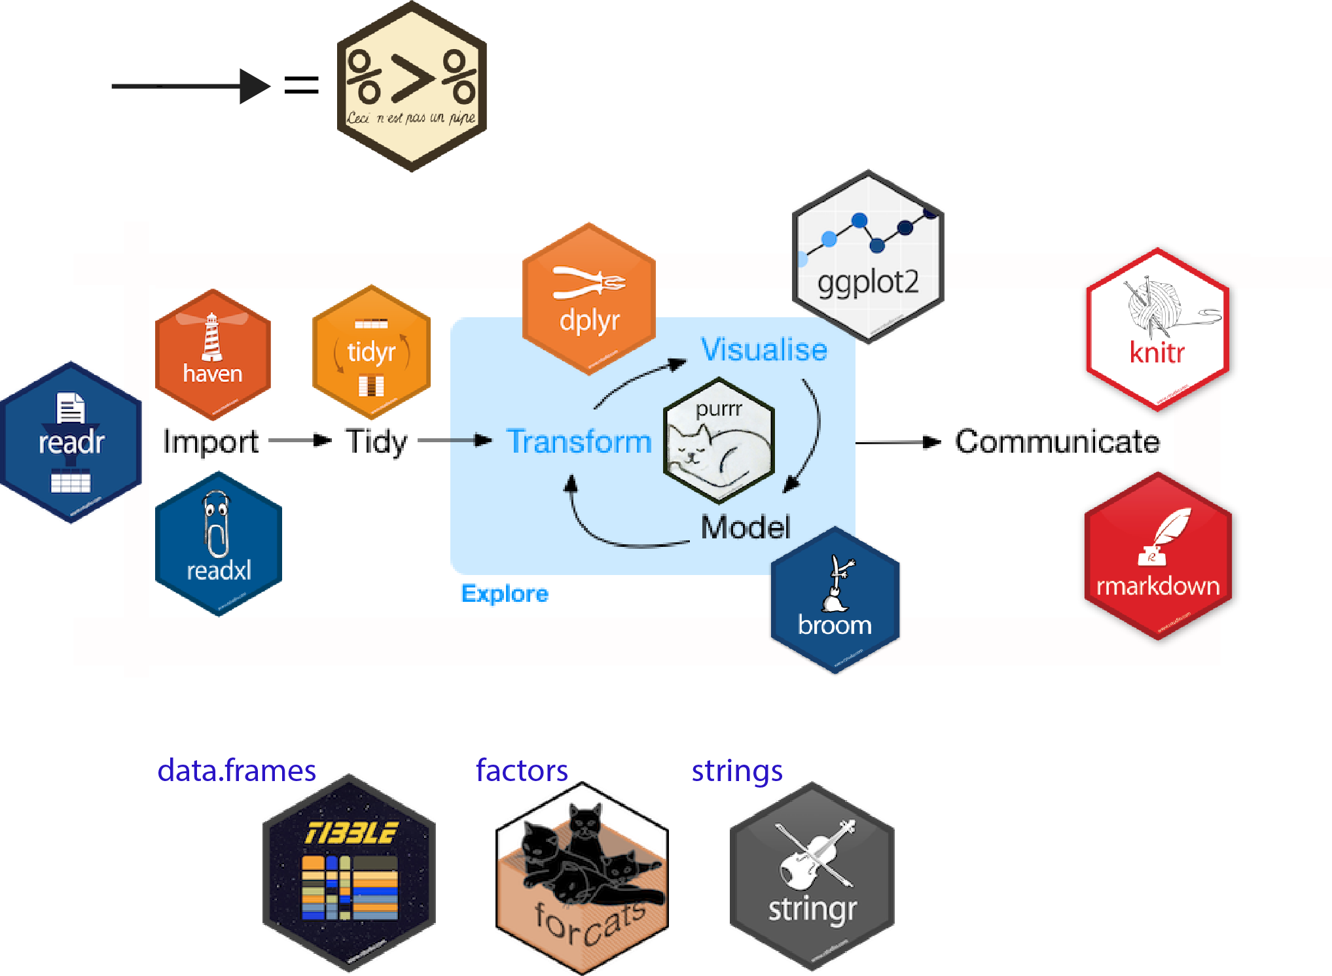
The Tidyverse
Image: beanumber.github.io
Note: we will not be covering the data.table package here

Slide 10
Notable Tidyverse architect: Hadley Wickham

Slide 11
The Python Programming Language
Initial release in 1991 by Guido van Rossum
Based on ABC, Modula and C languages
Named after the Monty Python comedian group
Designed to be easy to read and simple to learn
Used as a 'full-stack,' general-purpose language
Now the most popular—and second most loved—language (Stack Overflow)
Great community!

Slide 12
Python Pandas
Initially developed by Wes McKinney in 2008
A reaction to deficiencies in how the Python standard library handles data
Considerable functional design inspiration from R
Introduces the DataFrame and Series objects

Slide 13
Development Tools
Python | R
PyCharm | R Studio
Microsoft VSCode
Spyder
Vim/Emacs | Vim/Emacs
Jupyter notebooks | Jupyter notebooks

Slide 14
A Typical Exploratory Data Analysis Workflow
Importing Data
Inspection
Data cleaning and wrangling/munging
Visualization
Uni- and multi-variate analysis
Hypothesis testing
Construction of statistical models
Call to action
We will present a side-by-side comparison between Python and R for each step

Slide 15
Let's get to Analyzing!
Follow along with the code and notebooks
at: https://github.com/RaInta/PythonOrR

Slide 16
Package Versions
Python | R
print(f"System version: {sys.version}\n") print(f"Pandas version: {pd.__version__}\n") print(f"Numpy version: {np.__version__}\n") print(f"Matplotlib version: {mpl.__version__}\n") print(f"Seaborn version: {sns.__version__}\n") print(f"Statsmodels version: {sm.__version__}\n") Sytem version: 3.6.7 | packaged by conda-forge | (default, Feb 26 2019, 03:50:56) [GCC 7.3.0] Pandas version: 0.24.1 Numpy version: 1.15.4 Matplotlib version: 3.0.3 Seaborn version: 0.9.0 Statsmodels version: 0.9.0 | version$version.string packageVersion("RSQLite") packageVersion("readxl") packageVersion("Hmisc") packageVersion("dplyr") packageVersion("GGally") packageVersion("ggplot2") packageVersion("car") packageVersion("gvlma") packageVersion("MASS") 'R version 3.5.2 (2018-12-20)' [1] ‘2.1.1’ [1] ‘1.1.0’ [1] ‘4.1.1’ [1] ‘0.7.7’ [1] ‘1.4.0’ [1] ‘3.1.0’ [1] ‘3.0.2’ [1] ‘1.0.0.2’ [1] ‘7.3.51.1’

Slide 17
1: Importing Data
The user data is stored by the company on their SQL database.
We can easily access this in two lines:
Python | R
import sqlite3 # Connect to the database cnx = sqlite3.connect("../data/user_data.sql") In [7]: # The data are stored as two tables in the db: import pandas as pd users_df = pd.read_sql_query( "SELECT * FROM user_accounts", cnx) | library("RSQLite") In [15]: # Connect to the user database (here, a SQLite DB) con <- RSQLite::dbConnect(drv=RSQLite::SQLite(), dbname="../data/user_data.sql") # Import user information to a data.frame useRs_df <- dbGetQuery(con, 'SELECT * FROM user_accounts')

Slide 18
The Marketing Department stored the campaign in an Excel spreadsheet
Python | R
campaign_df = pd.read_excel( "../data/advertising_campaign.xlsx") | library("readxl") campaign_df <- read_excel( "../data/advertising_campaign.xlsx")

Slide 19
2: Exploratory Data Analysis (EDA)
Python | R
# Size of the dataset users_df.shape (11000, 12) # Names of columns: users_df.columns.values array(['user_id', 'first_name', 'last_name', 'email', 'password_hashed', 'gender', 'address', 'age', 'credit_card_num', 'credit_card_exp', 'security_answer', 'account_balance'], dtype=object) | # Size of the dataset dim(useRs_df) 11000 12 # Names of columns: names(useRs_df) 'user_id' 'first_name' 'last_name' 'email' 'password_hashed' 'gender' 'address' 'age' 'credit_card_num' 'credit_card_exp' 'security_answer' 'account_balance'

Slide 20
Python | R
# Quick look at the first few rows: users_df.head() | # Quick look at the first few rows: head(useRs_df)
user_id | first_name | last_name | email | …
3174 | Mac | Gilbert | athrocyte2057@yandex.com | …
6161 | Jacinto | Holloway | connelly2054@outlook.com | …
5976 | Yuko | Shaffer | carnell1945@gmail.com | …
6598 | Carlo | Logan | naturalistic2030@yahoo.com | …
8217 | Sandee | Wolfe | normoblastic1896@outlook.com | …
9978 | Bennie | Witt | dumper1986@live.com | …
 | user_id | first_name | last_name | email | …
0 | 3174 | Mac | Gilbert | athrocyte2057@yandex.com | …
1 | 6161 | Jacinto | Holloway | connelly2054@outlook.com | …
2 | 5976 | Yuko | Shaffer | carnell1945@gmail.com | …
3 | 6598 | Carlo | Logan | naturalistic2030@yahoo.com | …
4 | 8217 | Sandee | Wolfe | normoblastic1896@outlook.com | …

Slide 21
Accessing Fields and Subsets of the Data
Python | R
# Access the age column only: users_df["age"].head(10) 0 63 1 62 2 30 3 39 4 38 5 48 6 56 7 34 8 34 9 41 Name: age, dtype: int64 # Alternatively: users_df.loc[0:9, "age"] But NEVER: In [ ]: users_df.age.head(10) Just. Don't. Even if you see it on Stack Overflow. | # Access the age column only: head(useRs_df$age, 10) 63 62 30 39 38 48 56 34 34 41 In [26]: # Alternatively: head(useRs_df["age"], 10)

Slide 22
Numerical Summaries
Python | R
# Get the data types of each column users_df.dtypes user_id int64 first_name object last_name object email object password_hashed object ... age int64 credit_card_num object credit_card_exp object security_answer object account_balance float64 Length: 12, dtype: object # Get some descriptive statistics for the numerical data: users_df.describe() | # Get a neat summary of each column, including data types etc. str(useRs_df) 'data.frame': 11000 obs. of 12 variables: $ user_id : int 3174 6161 5976 6598 8217 9978 6928 9143 8682 9680 ... $ first_name : chr "Mac" "Jacinto" "Yuko" "Carlo" ... $ last_name : chr "Gilbert" "Holloway" "Shaffer" "Logan" ... $ email : chr "athrocyte2057@yandex.com" "connelly2054@outlook.com" "carnell1945@gmail.com" "naturalistic2030@yahoo.com" ... Etc.

Slide 23
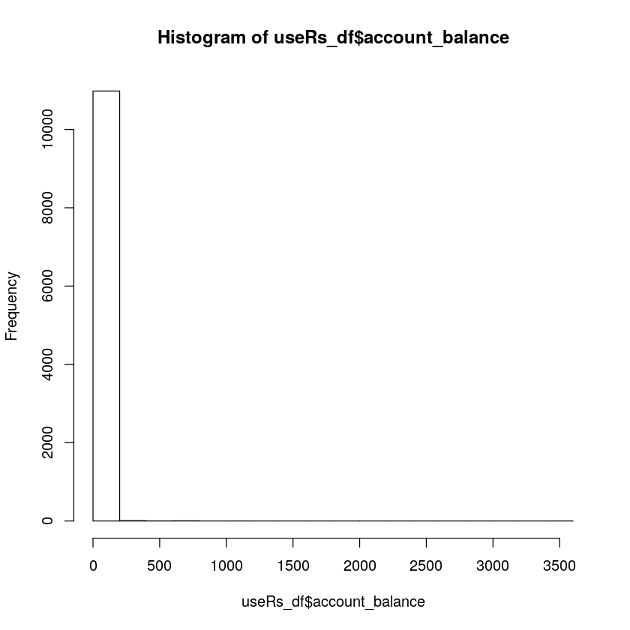
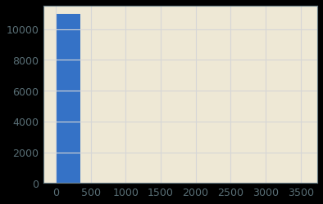
Univariate Descriptions
Python | R
# Univariate description of account balances: import matplotlib.pyplot as plt plt.hist(users_df["account_balance"]) # Alternatively: users_df["account_balance"].hist() | # Univariate description of account balances: hist(useRs_df$account_balance)

Slide 24
Data Transformations and Feature Engineering
Brutal!
Perhaps, like many resource distributions, this is a Pareto distribution. This will be clear if we log-transform the data:
Python | R
Import numpy as np users_df["log_account_balance"] = np.log10( users_df["account_balance"] + 1) | useRs_df$log_account_balance <- log10( useRs_df$account_balance + 1)

Slide 25
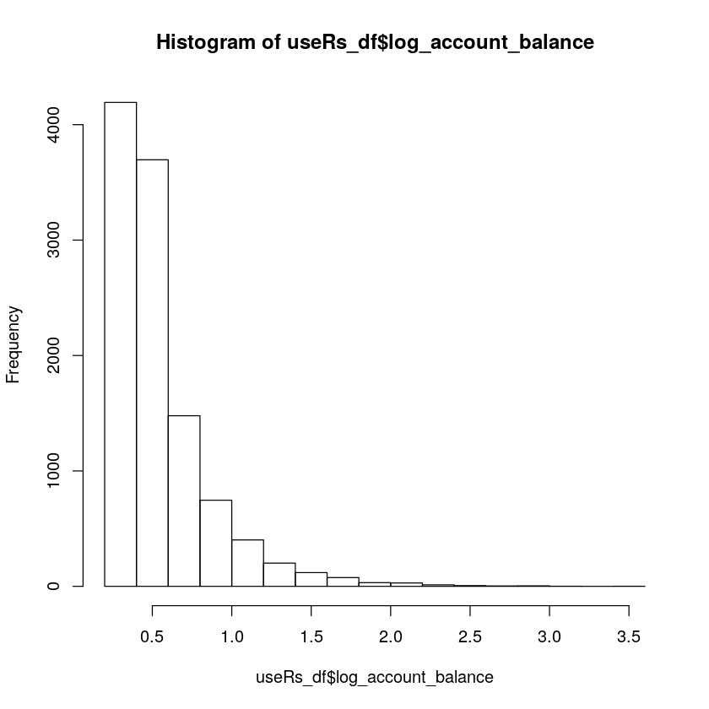
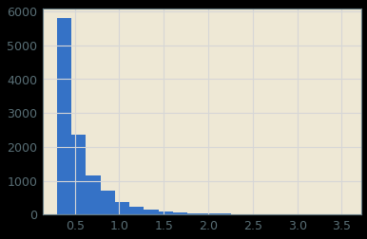
Python | R
users_df["log_account_balance"].hist(bins=20) | hist(useRs_df$log_account_balance)
Nice. It is likely a Pareto distribution (have you heard of the "80-20" rule?).

Slide 26
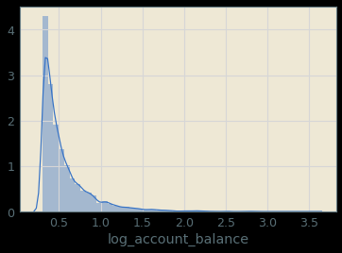
Python
import seaborn as sns sns.distplot(users_df["log_account_balance"])
Even nicer.

Slide 27
Handling Missing Data
Python | R
Python signifier: np.nan # Quantify the missingness: users_df.isnull().sum().sum() 2195 # We don't need the address column: del users_df["address"] # Alternatively: pop off the queue users_df.pop("address") # Change the default value of missing gender: In [42]: users_df["gender"].fillna("Unknown", inplace=True) users_df["gender"].sample(5) users_df["gender"].isnull().sum() 0 | R signifier: NA # Quantify the missingness: sum(is.na(useRs_df)) 2195 # We don't need the address column: useRs_df$address <- NULL In [34]: # Change the default value of missing gender: useRs_df[is.na(useRs_df)] <- "Unknown" sample(useRs_df, 5) describe(useRs_df) sum(is.na(useRs_df$gender)) # None 0

Slide 28
Remove Duplicates
Python | R
users_df.duplicated().sum() 1000 Drop duplicates users_df.drop_duplicates(inplace=True) users_df.duplicated().sum() 0 | sum(duplicated(useRs_df)) 1000 dim(unique(useRs_df)) 10000 12 # Drop duplicates useRs_df <- unique(useRs_df) sum(duplicated(useRs_df)) 0

Slide 29
Merge DataFrames
Merge the user data and the corresponding advertising campaign data.
Always check key properties of your DataFrame after a merge!
Python | R
data_df = pd.merge(users_df, campaign_df, on="user_id", how="left") data_df.shape (10000, 14) data_df.columns.values array(['user_id', 'first_name', 'last_name', 'email', 'password_hashed', 'gender', 'age', 'credit_card_num', 'credit_card_exp', 'security_answer', 'account_balance', 'log_account_balance', 'marketing_level', 'sales'], dtype=object) data_df.duplicated().sum() 0 data_df.isnull().sum() user_id 0 first_name 0 last_name 0 email 0 password_hashed 0 … | library("dplyr") data_df <- merge(x=useRs_df, y=campaign_df, by="user_id", all.x=TRUE) dim(data_df) 10000 14 names(data_df) 'user_id' 'first_name' 'last_name' 'email' 'password_hashed' 'gender' 'age' 'credit_card_num' … sum(duplicated(useRs_df)) 0 sum(is.na(useRs_df)) 0

Slide 30
Hypothesis Testing
What was the question again?
Does the marketing level have any effect on sales?
Python | R
data_df.groupby("age_demographic").mean( )["sales"] | data_df %>% group_by(marketing_level) %>% summarise(mean_sales=mean(sales))

Slide 31
Upon discussion, Marketing finally(!) let us know that their advertising campaign was targeted at customers between the ages of 25 and 35.
Was this campaign effective?
Python | R
# Let's engineer that feature a little more: data_df["age_demographic"] = np.where( [x >= 25 and x <= 35 for x in data_df["age"]], "yes", "no") # Make it a categorical variable: data_df["age_demographic"] = data_df[ "age_demographic"].astype('category') data_df.dtypes user_id int64 … age_demographic category Length: 16, dtype: object In [50]: data_df.groupby( "age_demographic").mean()["sales"] | data_df$age_demographic <- as.factor( ifelse(data_df$age >= 25 & data_df$age <=35, "yes", "no")) data_df %>% group_by(age_demographic) %>% summarise(mean_sales=mean(sales))
age_demographic | mean_sales
no | 2.613189
yes | 7.911501

Slide 32
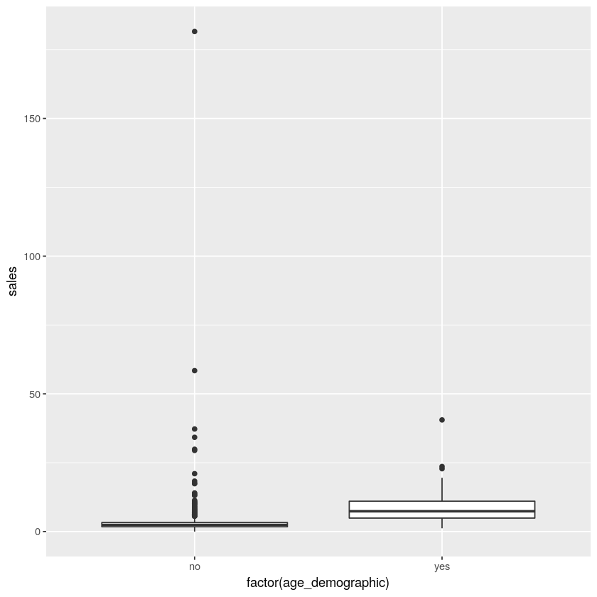
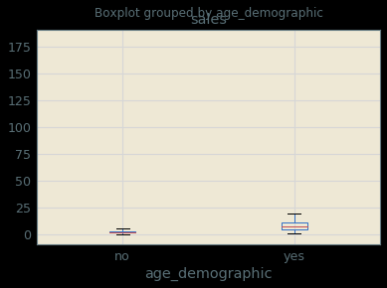
Python | R
data_df.boxplot("sales", by="age_demographic") | library(ggplot2) ggplot(data_df, aes(y=sales, x=age_demographic)) + geom_boxplot()

Slide 33
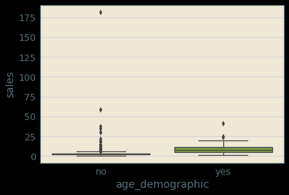
Alternatively, Seaborn produces nicer box-plots with Python
Python
# Alternatively (and nicer handling of outliers for the Python version): sns.boxplot(x="age_demographic", y="sales", data=data_df)

Slide 34
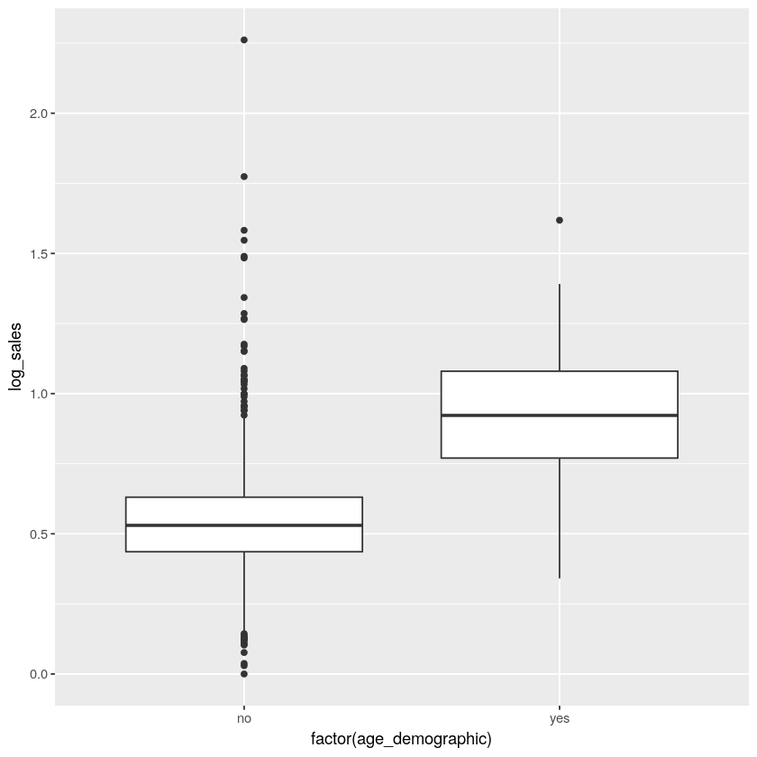
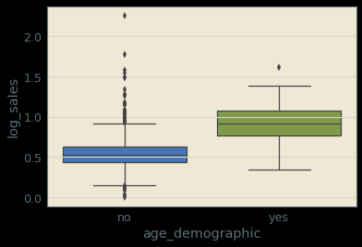
It looks like we're swamped by the skewed distribution in sales.
Time for the log-transformed version:
Python | R
data_df["log_sales"] = np.log10(data_df["sales"] + 1) sns.boxplot(x="age_demographic", y="log_sales", data=data_df) | data_df$log_sales <- log10(data_df$sales + 1) ggplot(data_df, aes(y=log_sales, x=age_demographic)) + geom_boxplot()

Slide 35
Performing a T-Test
Python | R
import statsmodels.api as sm sm.stats.ttest_ind( data_df.loc[ data_df["age_demographic"] == "no", "sales"], data_df.loc[ data_df["age_demographic"] == "yes", "sales"]) # t-stat, p-value, df: (-77.41724322823191, 0.0, 9998.0) In [57]: # More compact---but a little more ninja: sm.stats.ttest_ind(*(x[1] for x in data_df.groupby( "age_demographic")["sales"])) | t.test(sales ~ age_demographic, data=data_df, var.equal=TRUE) Two Sample t-test data: sales by age_demographic t = -77.417, df = 9998, p-value < 2.2e-16 alternative hypothesis: true difference in means is not equal to 0 95 percent confidence interval: -5.432465 -5.164158 sample estimates: mean in group no mean in group yes 2.613189 7.911501
Conclusion: We can safely reject the null hypothesis.
The marketing campaign appears to have been highly effective
for the target demographic.

Slide 36
How Else Can We Add Value?
Are there more granular ways we can maximize sales?

Slide 37
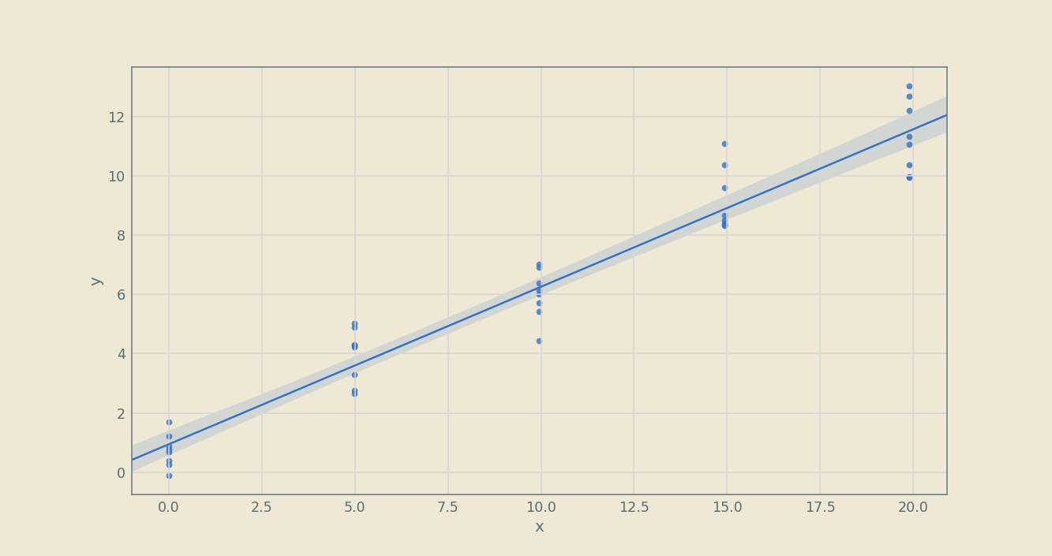
Linear Regression

Slide 38
Linear Regression
Python | R
# Take our null model as the mean sales value: data_df["sales"].mean() 3.795772486289269 In [59]: import statsmodels.formula.api as smf mod_null = smf.ols( "sales ~ 1", data=data_df).fit() | # Null model: intercept only mod_null <- lm(sales ~ 1, data=data_df)

Slide 39
Formula Syntax
Symbol | Meaning
~ | Separates response variable (left-hand side) from explanatory variables
1 | Intercept (implied on right-hand side)
x + y | Union of x and y terms
x - y | Removal of y term
x:y | Calculate interaction term between x and y
x*y | Equivalent to x + y + x:y
I() | Identity: compute mathematical transformation in parentheses
C() | Convert term to categorical
bs() | Compute B-spline (default: cubic)

Slide 40
Python | R
mod_null.summary() | summary(mod_null) Call: lm(formula = sales ~ 1, data = data_df) Residuals: Min 1Q Median 3Q Max -3.796 -1.900 -1.018 0.343 177.778 Coefficients: Estimate Std. Error t value Pr(>|t|) (Intercept) 3.79577 0.03604 105.3 <2e-16 *** --- Signif. codes: 0 ‘***’ 0.001 ‘**’ 0.01 ‘*’ 0.05 ‘.’ 0.1 ‘ ’ 1 Residual standard error: 3.604 on 9999 degrees of freedom
OLS Regression Results
Dep. Variable: | sales | R-squared: | 0
Model: | OLS | Adj. R-squared: | 0
Method: | Least Squares | F-statistic: | -inf
Date: | Tue, 25 Jun 2019 | Prob (F-statistic): | nan
Time: | 15:08:31 | Log-Likelihood: | -27009
No. Observations: | 10000 | AIC: | 5.40E+04
Df Residuals: | 9999 | BIC: | 5.40E+04
Df Model: | 0
Covariance Type: | nonrobust
 | coef | std err | t | P>|t| | [0.025 | 0.975]
Intercept | 3.7958 | 0.036 | 105.325 | 0 | 3.725 | 3.866
Omnibus: | 18917.269 | Durbin-Watson: | 2.006
Prob(Omnibus): | 0 | Jarque-Bera (JB): | 150663349.9
Skew: | 13.825 | Prob(JB): | 0
Kurtosis: | 603.689 | Cond. No. | 1
Warnings:
[1] Standard Errors assume that the covariance matrix of the errors is correctly specified.

Slide 41
What if people with higher account balances spent more?
We can add account balance as a factor to our model.
Python | R
# Single factor: account balance mod0 = smf.ols("sales ~ account_balance", data=data_df).fit() mod0.summary() | mod0 <- lm(sales ~ account_balance, data=data_df) summary(mod0) Call: lm(formula = sales ~ account_balance, data = data_df) Residuals: Min 1Q Median 3Q Max -3.6234 -1.7984 -0.9627 0.3629 11.3991 Coefficients: Estimate Std. Error t value Pr(>|t|) (Intercept) 3.5355274 0.0296030 119.43 <2e-16 *** account_balance 0.0498526 0.0007014 71.07 <2e-16 *** --- Signif. codes: 0 ‘***’ 0.001 ‘**’ 0.01 ‘*’ 0.05 ‘.’ 0.1 ‘ ’ 1 Residual standard error: 2.938 on 9998 degrees of freedom Multiple R-squared: 0.3356, Adjusted R-squared: 0.3356 F-statistic: 5051 on 1 and 9998 DF, p-value: < 2.2e-16
OLS Regression Results
Dep. Variable: | sales | R-squared: | 0.336
Model: | OLS | Adj. R-squared: | 0.336
Method: | Least Squares | F-statistic: | 5051
Date: | Tue, 25 Jun 2019 | Prob (F-statistic): | 0
Time: | 15:08:49 | Log-Likelihood: | -24964
No. Observations: | 10000 | AIC: | 4.99E+04
Df Residuals: | 9998 | BIC: | 5.00E+04
Df Model: | 1
Covariance Type: | nonrobust
 | coef | std err | t | P>|t| | [0.025 | 0.975]
Intercept | 3.5355 | 0.03 | 119.431 | 0 | 3.477 | 3.594
account_balance | 0.0499 | 0.001 | 71.072 | 0 | 0.048 | 0.051
Omnibus: | 3834.938 | Durbin-Watson: | 1.981
Prob(Omnibus): | 0 | Jarque-Bera (JB): | 12307.597
Skew: | 2.021 | Prob(JB): | 0
Kurtosis: | 6.632 | Cond. No. | 42.5

Slide 42
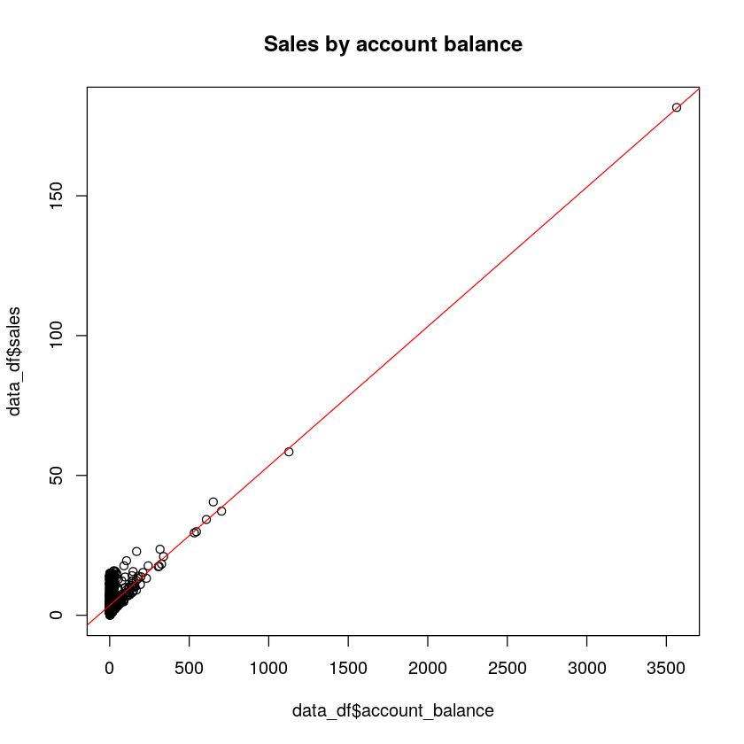
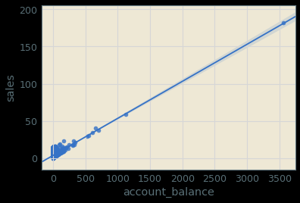
Python | R
sns.regplot(x="account_balance", y="sales", data=data_df) | plot(data_df$account_balance, data_df$sales, main="Sales by account balance") abline(mod0, col="red")

Slide 43
Clues for Multilinear Regression
What other factors might lead to increased sales?
Python | R
import seaborn as sns sns.pairplot( data_df[["log_account_balance", "age", "marketing_level", "log_sales", "age_demographic"]], hue='age_demographic') | library(car) scatterplotMatrix(data_df[c('sales', 'account_balance', 'age', 'marketing_level')], spread=FALSE, lty.smooth=2, main="Scatter Plot Matrix") library("GGally") ggpairs(data_df[c("log_account_balance", "age", "marketing_level", "log_sales")])
(See the accompanying notebooks for more details)

Slide 44
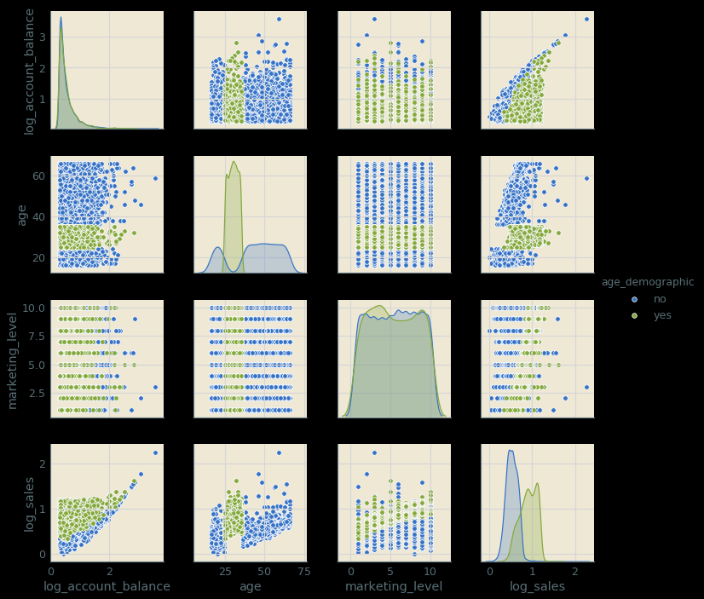
Python

Slide 45
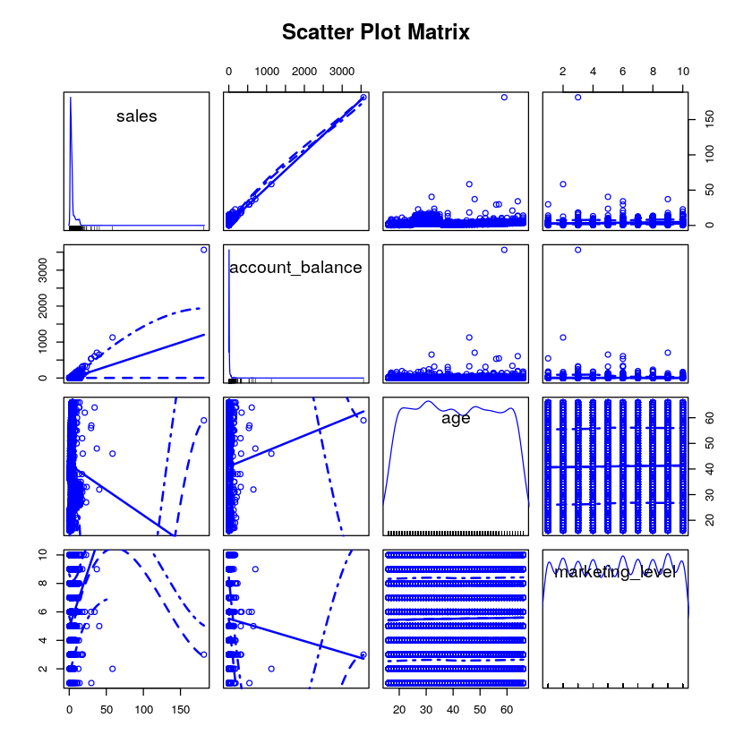
R

Slide 46
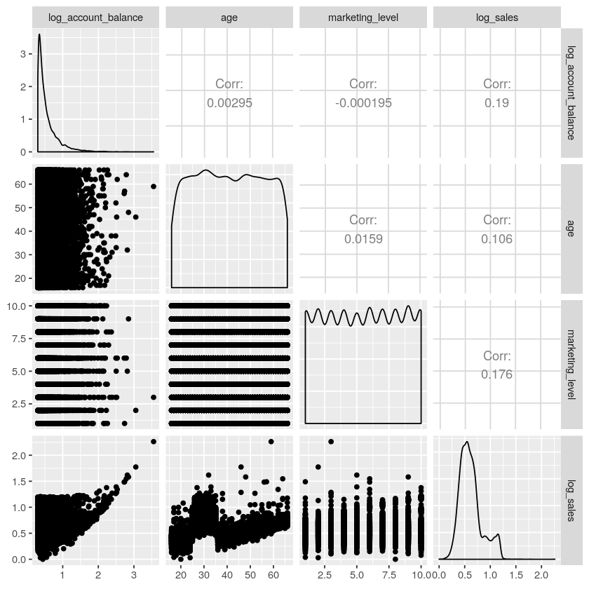
R

Slide 47
After Some Factor Hunting…
(again, see the notebooks for details!)
Python | R
mod3 = smf.ols( "sales ~ age + I(age**2) + marketing_level:age_demographic + account_balance", data=data_df).fit() mod3.summary() | mod3 <- lm(sales ~ age + I(age**2) + marketing_level:age_demographic + account_balance, data=data_df) summary(mod3) Coefficients: Estimate Std. Error t value Pr(>|t|) (Intercept) 2.032e+00 6.910e-02 29.405 <2e-16 *** age -6.705e-02 3.580e-03 -18.726 <2e-16 *** I(age^2) 1.509e-03 4.347e-05 34.721 <2e-16 *** account_balance 5.000e-02 1.955e-04 255.766 <2e-16 *** marketing_level:age_demographicno -3.147e-03 2.935e-03 -1.072 0.284 marketing_level:age_demographicyes 1.142e+00 3.912e-03 291.920 <2e-16 *** Residual standard error: 0.8184 on 9994 degrees of freedom Multiple R-squared: 0.9485, Adjusted R-squared: 0.9484 F-statistic: 3.678e+04 on 5 and 9994 DF, p-value: < 2.2e-16
 | coef | std err | t | P>|t| | [0.025 | 0.975]
Intercept | 2.032 | 0.069 | 29.405 | 0 | 1.897 | 2.167
age | -0.067 | 0.004 | -18.726 | 0 | -0.074 | -0.06
I(age ** 2) | 0.0015 | ######## | 34.721 | 0 | 0.001 | 0.002
marketing_level:age_demographic[no] | -0.0031 | 0.003 | -1.072 | 0.284 | -0.009 | 0.003
marketing_level:age_demographic[yes] | 1.1418 | 0.004 | 291.92 | 0 | 1.134 | 1.15
account_balance | 0.05 | 0 | 255.766 | 0 | 0.05 | 0.05

Slide 48
There is a strong interaction between marketing level and the target demographic; there's a strong dependence on account balance, and there is a polynomial dependence on players' ages on in-game sales.
So how can we make actionable predictions on future strategies?

Slide 49
Model Prediction
Create a DataFrame that spans the range of our desired parameters.
Let's see what happens if we turn our marketing UP TO ELEVEN!!!!
Python | R
pred_df = pd.DataFrame( {"age": list(np.arange(16, 65, 5))*2*100*11, "age_demographic":["yes","no"]*10*100*11, "account_balance": list(np.arange(0, 1000, 10))*10*2*11, "marketing_level": list(np.arange(1, 12))*10*2*100} ) In [77]: # Generate the predicted sales according to the model : pred_df['pred_sale_amount'] = mod3.predict( pred_df) In [78]: # Plot the model sns.lmplot("marketing_level", 'pred_sale_amount', data=pred_df, hue="age_demographic") | pred_df <- expand.grid("age"=seq(16, 65, 5), "age_demographic"=c("yes","no"), "account_balance"=seq(0, 1000, 10), "marketing_level"=1:10 ) Predict new results In [54]: pred_df$sales_pred <- predict(mod3, pred_df) Visualize these results In [55]: ggplot(pred_df, aes(x=marketing_level, y=sales_pred, color=age_demographic, alpha=0.5)) + geom_point()

Slide 50
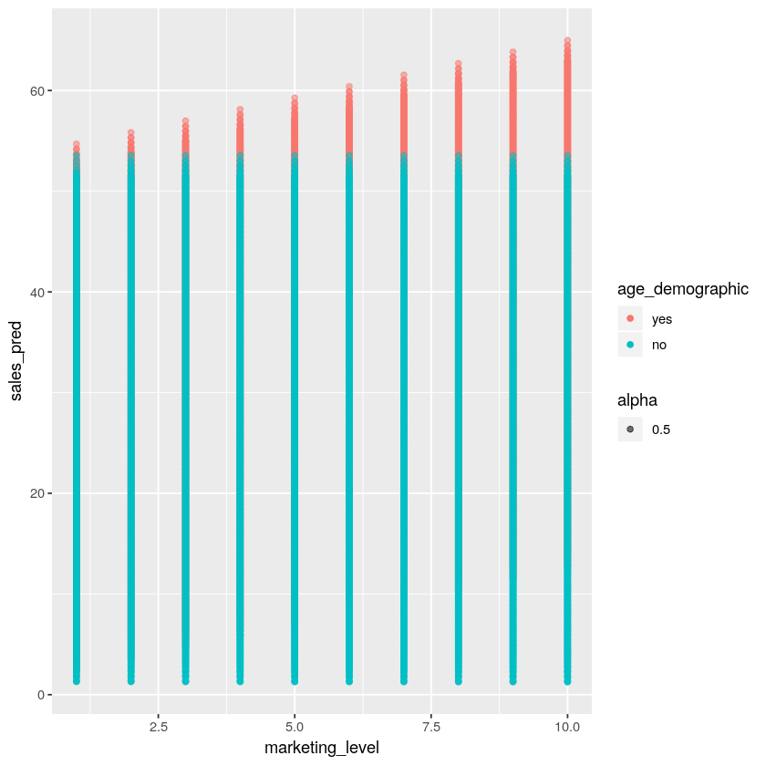
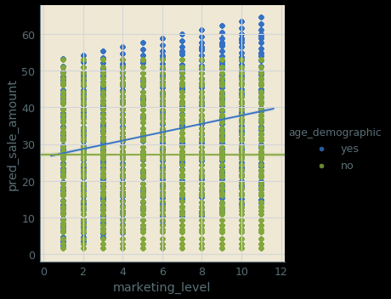
Python | R
Yes!!! We can turn it up to eleven. It would be wrong not to!

Slide 51
Model Selection
Python | R
print(*[f"AIC for model {n}: {x.aic}\n" for n, x in enumerate([mod0, mod1, mod2, mod3, mod4, mod5])]) AIC for model 0: 49932.38421984795 AIC for model 1: 53998.032001277854 AIC for model 2: 37707.50498856515 AIC for model 3: 24377.55339611073 AIC for model 4: 44585.14647833382 AIC for model 5: 44632.83750403216 | AIC(mod0, mod1, mod2, mod3, mod4, mod5) library(gvlma) gvmod3 <- gvlma(mod3) summary(gvmod3)
Model 3 is the most generalizable. We'll recommend this one.

Slide 52
R
stepAIC(mod6, direction="backward") Start: AIC=-4001.22 sales ~ age + I(age^2) + marketing_level:age_demographic + account_balance Df Sum of Sq RSS AIC <none> 6694 -4001.2 age 1 235 6929 -3658.4 I(age^2) 1 808 7502 -2864.3 account_balance 1 43818 50513 16206.4 marketing_level:age_demographic 2 78164 84858 21392.0 Call: lm(formula = sales ~ age + I(age^2) + marketing_level:age_demographic + account_balance, data = data_df) Coefficients: (Intercept) age 2.031974 -0.067047 I(age^2) account_balance 0.001509 0.049995 marketing_level:age_demographicno marketing_level:age_demographicyes -0.003147 1.141848

Slide 53
Conclusion
Model 3 is the best!
In other words: sales are a function of account balance, age (with a weak square term), plus a strong interaction between marketing level and target demographic (ages between 25 and 35).
BOTTOM LINE: There is no observable market saturation for the target demographic. Perhaps further increase sales by targeting older players, and those with higher account balances. Perhaps a 'premier tier' account level?

Slide 54
Machine Learning and Big Data Libraries
Python | R
Machine Learning
Scikit-learn PyTorch TensorFlow + Keras | CARET (Classification And Regression Training) nnet e1071
Big Data
PySpark | SparklyR SparkR
Plenty more!

Slide 55
Other Resources
Books
Python | R
"Python Data Science Handbook" (Jake VanderPlas) "Python for Data Analysis, 2nd ed." (Wes McKinney) | "R for Data Science" (Hadley Wickham & Garrett Grolemund) "An Introduction to Statistical Learning with Applications in R" (Gareth James, Daniela Witten, Trevor Hastie & Robert Tibshirani)
Websites
Python | R
www.python.org https://realpython.com | www.r-project.org www.r-bloggers.com

Slide 56
October 2017
Thank you for Watching!
Check out our classes on Data Science https://www.accelebrate.com/php-python-r-training
Accelebrate offers a wide array of security training, including classes focused on specific programming languages (Java, .NET, JavaScript) and operating systems (Linux, Windows).
Contact us for private, customized training for 3 or more people.
https://www.accelebrate.com
info@accelebrate.com
International: +1 678 648 3113
US & Canada: +1 877 849 1850

